Slide 1
DATA SCIENCE
Time Series

Slide 2
AGENDA
pip install statsmodels
Importing time series data
Holt-Winters
Autocorrelation
Separating trends and seasons
ARIMA

Slide 3
Why are time series interesting and challenging?
Derivatives (differences between consecutive data points) are important
Even the ratio is interesting
Often self-correlated (values depend on previous values)
Hard to disentangle other time-related effects
Python libraries are a bit of a mess
Resampling in Pandas
We’ll use statsmodels for ARIMA
Has wonderful but undocumented functions like decompose_seasonal()
DIY for Holt-Winters

Slide 4
Typical Time Series Components
Time Series
Trend Component
Periodic Components
Other Time-related source
Quarterly
Monthly
Annual
Daily
Noise
Weather
Economic
Demographic

Slide 5
IMPORTING TIME SERIES DATA
DATA SCIENCE PART TIME COURSE

Slide 6
When the data has dates in it
# CollectionTime column looks like 2015-03-01 12:15
import pandas
DF = pandas.read_csv(’…’,parse_dates=’CollectionTime’,
index_col=’CollectionTime’)
# Column 10 has the year, column 11 has the month
import pandas
DF = pandas.read_csv(’…’,
parse_dates={’YM’:[10,11]},
index_col=’YM’)
Desperate? Try date_parser=…

Slide 7
If there is no date field, but each row is a fixed-time sample
import pandas
Sample_times = pandas.date_range('2016-07-25’,
periods=10, freq='B')
Raw = pandas.read_csv(’…’)
DF = pandas.DataFrame(
data={’col1’: list(Raw.Col1),
’col2’: list(Raw.Col2)},
index=Sample_times
)

Slide 8
Offset Aliases / Frequencies
B business day
D calendar day
W weekly
M month end
BM business month end
MS month start
Q quarter end
BQ business quarter
A year end
H hourly
T minutely
S secondly
Can be combined with a number e.g. 5T, 4W

Slide 9
Interesting time-related Series & DataFrame functions
DataFrame or Series
.shift(-1) – data associated with previous timestamp
.shift(1) – data associated with next timestamp
Series only
.asof(“2015-01-16 15:31”) – closest sample, doesn’t have to be in index

Slide 10
Sampling, rolling mean
series.resample(“A”).sum()
series.resample(“1W”).max()
series.rolling(“12M”).mean()

Slide 11
Holt-Winters
DATA SCIENCE PART TIME COURSE

Slide 12
Why Holt-Winters?
Conceptually simple
Works quite well
Easy to implement
Not in scikit-learn, nor pandas
We’ll use a library I found on github
https://gist.github.com/danuker/214fce037832a5544b74

Slide 13
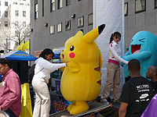
How to predict my Pokemon catch today
I might not play at all
Or I might play a lot
All you can do is predict that tomorrow I’ll have the same number as today
Pokedata=[3,3,2,1,4,…,6,7,8]
Prediction=Pokedata[-1]

Slide 14
How to predict my Pokemon catch today (part 2)
But if I play on one day, I’m probably likely to play the next day
If I’m too busy to play one day, I’m probably too busy to play the next day
So it would be better to take the average of the last couple of days
Pokedata=[3,3,2,1,4,…,6,7,8]
def prediction(data, days=5):
answer=0.0
for i in range(1,days):
answer+=data[-i]
return answer/days

Slide 15
How to predict my Pokemon catch today (part 3)
But that means that the one day’s play 5 days ago has the same impact on the prediction as yesterday’s
So it would be better to weight the average of the last couple of days
Pokedata=[3,3,2,1,4,…,6,7,8]
Weightings=[0.4, 0.3, 0.2, 0.1]
def prediction(data, weights):
answer=0.0
for i in range(1,len(weights)):
answer+=data[-i]*weights[i-1]
return answer

Slide 16
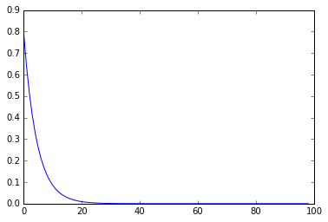
How to predict my Pokemon catch today (part 4)
Why those weights? Why stop at 4?
Exponential decay lets us include all prior data
Pokedata=[3,3,2,1,4,…,6,7,8]
Decay_rate=0.5
def prediction(data):
answer=0.0
for i in range(len(data)):
answer=answer*(1-Decay_rate) + data[i]*Decay_rate
return answer

Slide 17

How to predict my Pokemon catch today (Part 5)
But over time, I’ll probably get better, so we’d better include a trend
Pokedata=[3,3,2,1,4,…,6,7,8]
Decay_rate=0.5
def prediction(data):
Trend=data[-1]-data[-2]
answer=0.0
for i in range(len(data)):
answer=answer*(1-Decay_rate) + data[i]*Decay_rate
return answer+Trend

Slide 18
How to predict my Pokemon catch today (Part 6)
But after a while, I might reach the limits of how good I can get, so we should weight the trend
Pokedata=[3,3,2,1,4,…,6,7,8]
Decay_rate=0.5
def prediction(data):
answer=0.0
decayed_trend = 1.0
for i in range(1,len(data)):
todays_trend=data[i]-data[i-1]
decayed_trend = decayed_trend*(1-Decay_rate)+
todays_trend*Decay_rate
answer=answer*(1-Decay_rate) + data[i]*Decay_rate
return answer+Trend

Slide 19
How to predict my Pokemon catch today (Part 7)
And I’ll spend more time playing at weekends than weekdays, so we should consider data from exactly 7 days ago highly predictive
return (answer+trend)*(1-Decay_rate)
+data[-7]*Decay_rate

Slide 20
Put it all together… that’s Holt-Winters
Also known as triple-exponential smoothing:
Current value
Trend
1 Seasonal component
Comes in two flavours:
Additive
A special case of SARIMA, so SARIMA is used more commonly.
Example: there are 10 fewer customers on weekends
Multiplicative
When the seasonal component is proportional to the quantity
Example: there’s a 10% drop during Winter
Requires all data to be present, or fully interpolated

Slide 21
How do we choose the decay rates?
The algorithm starts with an initial decay rate for season, trend and level
It adjusts itself to find the best match for the data

Slide 22
In code
import holtwinters
prediction = holtwinters.multiplicative(
list(pandas_series_data)[:-24],
12,
60
)
Leave off some data so that you can compare how well the prediction matches reality
What’s the cycle length for the seasonal component?
This library doesn’t understand pandas data
How far ahead do you want to predict?

Slide 23
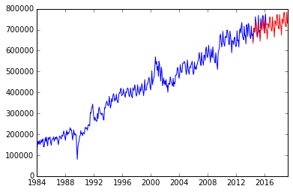
Using it
import holtwinters
prediction = holtwinters.multiplicative(
list(pandas_series_data)[:-24],
12,
60)
(data, level_decay, trend_decay,
seasonal_decay, root_mse) = prediction
pred_stamps = pandas.date_range(start='…', periods=60,
freq='…')
pred_series = pandas.Series(data=data, index=pred_stamps)
matplotlib.pyplot(pandas_series_data)
matplotlib.pyplot.plot(pred_series, c="red")

Slide 24
References
http://grisha.org/blog/2016/01/29/triple-exponential-smoothing-forecasting/

Slide 25
Domestic flights https://data.gov.au/dataset/domestic-airlines-top-routes-and-totals
DATA SCIENCE PART TIME COURSE

Slide 26
Auto-correlation
DATA SCIENCE PART TIME COURSE

Slide 27
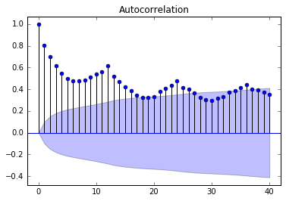
Are values correlated to their predecessors?
import statsmodels.api
statsmodels.api.graphics.tsa.plot_acf(pandas_series,
lags=40)
Out of shaded area?
Probably real
Shaded area?
Could be by chance
Spikes mean seasonal behaviour

Slide 28
Partial auto-correlation
If there’s a correlation between points and their predecessors, then there will be a correlation between the point and its pre-predecessor, and pre-pre-pre-predecessor, and so on.
It will get weaker
Partial auto-correlation says “what is the correlation between a point and its (pre-pre-pre…)-decessor when you take this into account?”

Slide 29
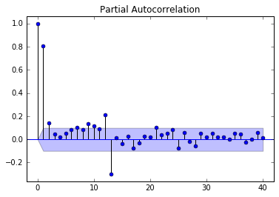
Are values correlated to their predecessors?
import statsmodels.api
statsmodels.api.graphics.tsa.plot_pacf(pandas_series,
lags=40)
Return flight that month or next month?
12-month seasonal fluctuation
Reflected echo effect

Slide 30
Separating trends and seasonality
DATA SCIENCE PART TIME COURSE

Slide 31
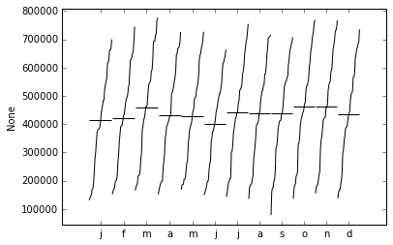
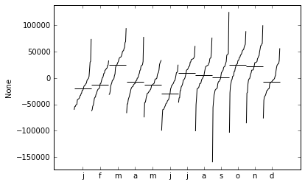
Plotting monthly trends
statsmodels.api.graphics.tsa.month_plot(series)
Original
Detrended

Slide 32
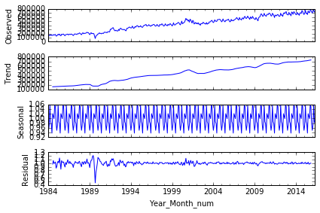
Rolling averages
dcr = statsmodels.api.tsa.seasonal_decompose(series,
model='multiplicative’, freq=12)
dcr.plot()

Slide 33
Decompose Result
Four Pandas series created:
dcr.trend
dcr.seasonal
dcr.resid
dcr.observed
Multiplicative model:
.observed == .trend * .seasonal * .resid
Additive model
observed == .trend + .seasonal + .resid

Slide 34
ARIMA (and how to decompose manually)
DATA SCIENCE PART TIME COURSE

Slide 35
ARIMA
In statistics and econometrics, and in particular in time series analysis, an autoregressive integrated moving average (ARIMA) model is a generalization of an autoregressive moving average (ARMA) model. These models are fitted to time series data either to better understand the data or to predict future points in the series (forecasting). They are applied in some cases where data show evidence of non-stationarity, where an initial differencing step (corresponding to the "integrated" part of the model) can be applied to reduce the non-stationarity

Slide 36
Taking out the trend
Try to make sure you have a whole number of seasonal cycles
Detrended = statsmodels.tsa.tsatools.detrend(series)
Trend = series – Detrended
Add the parameter order=2 if there is a quadratic underlying trend
Ugly code to identify the actual trend information:
ols = sklearn.linear_model.LinearRegression()
Time_as_dataframe=pandas.DataFrame(
data={'t': [x.toordinal() for x in trend.index]}
)
ols.fit(Time_as_dataframe, list(Trend))
print ols.coef_

Slide 37
Looking at the seasonal component
series[0::12] – every 12th element, starting at the first element
series[1::12] – every 12th element, starting at the second element
series[1::12].mean() – the mean of those elements
[series[i::12].mean() for i in range(12)] – a list of means which you can display with matplotlib
([….] * 50)[:len(series)] – list of seasonal components which is the same size as the series
series - ([….] * 50)[:len(series)] – series with seasonal components removed (as long as it is trend-free)
Repeat for as many seasonal components as there are in the data set

Slide 38
Now check ACF and PACF and mean again
Mean should be zero
No long-term ACF or PACF – only short-term correlations
Remember ACF length as “MA”
Remember PACF length as “AR”

Slide 39
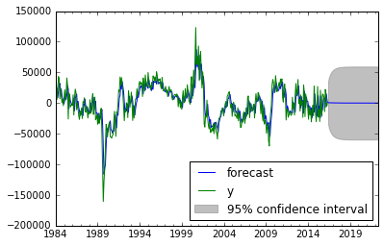
Make an ARMA model
a = statsmodels.api.tsa.ARIMA(dry_series, (2,0,2))
arw = a.fit()
arw.plot_predict('1984-01-01', '2022-05-01')
# To turn into actual numbers, add season and trend back in.
Residuals =
series – arw.predict('1984-01-01', '2016-05-01')

Slide 40
LAB
DATA SCIENCE PART TIME COURSE

